Slide 1
Neural microcolumns as transmission lines: firing rate encoding analysis
Vincent Baker
Drexel University Department of Physics

Slide 2
Observations
The firing of individual neurons is unpredictable. Information in the brain is therefore encoded by the firing of populations of neurons.
Cognitive neuroscience views information as passing between populations of neurons, both within and between functional areas of the brain.
We propose that small columnar ensembles (SCE) can transport information between neural populations via traveling waves of neural activations. SCEs can provide reliable transport of population firing rate information. SCEs can also provide a “recoding” function, mapping the average firing rate information of a population of neurons into the frequency of traveling waves.

Slide 3
SCE population dynamics
Traveling waves in SCEs have an “all-or-nothing” response, as an evoked traveling wave has a high level of synchronized firing activity
Traveling waves in SCEs have a refractory period due to the refractory period of the neurons triggered by the traveling wave
Key question: can the frequency of occurrence of traveling waves in an SCE encode the average firing rate of a population of neurons?

Slide 4
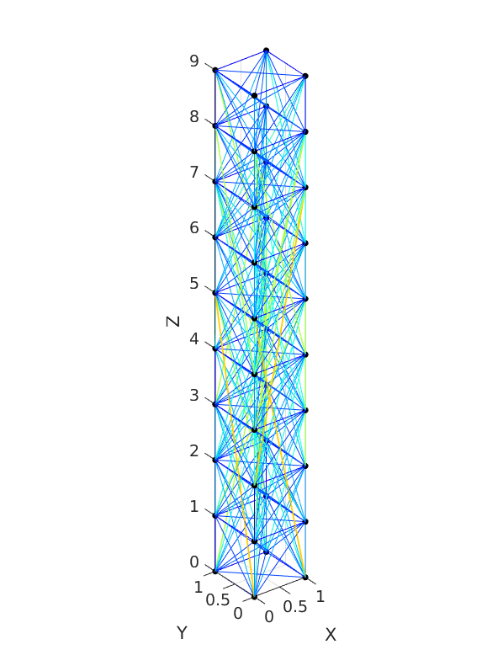
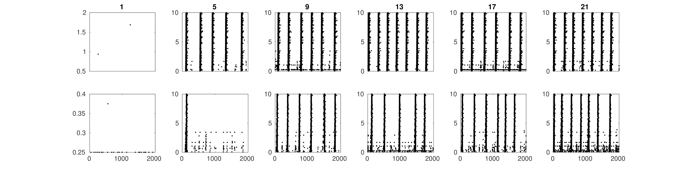
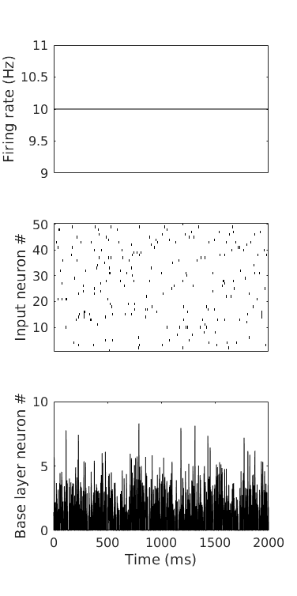
Experiment
Output layer
Spike raster plot of a population of 50 neurons with a 10 Hz average firing rate.
Input layer
Population of neurons whose average firing rate we want to encode and transmit
2 seconds

Slide 5
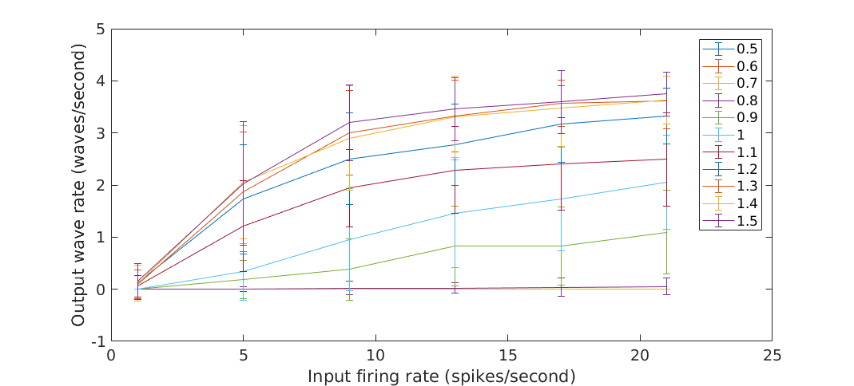
Results
The activation function of the SCE depends upon the connection strength K
Connection strength scale
1.0 – K = 24
0.5 – K = 12
1.5 – K = 36

Slide 6
Reliable transport
Single neurons are not reliable, therefore information cannot be encoded in the firing of a single neuron alone
Similarly, a single SCE may be susceptible to neuron or connection damage, implying that a “population” of SCE may be required for reliable coding and transport of information
We test the reliability of a single SCE by removing some neurons at random to simulate neuronal damage and find that removing 5% of the neurons can destroy the activation function

Slide 7
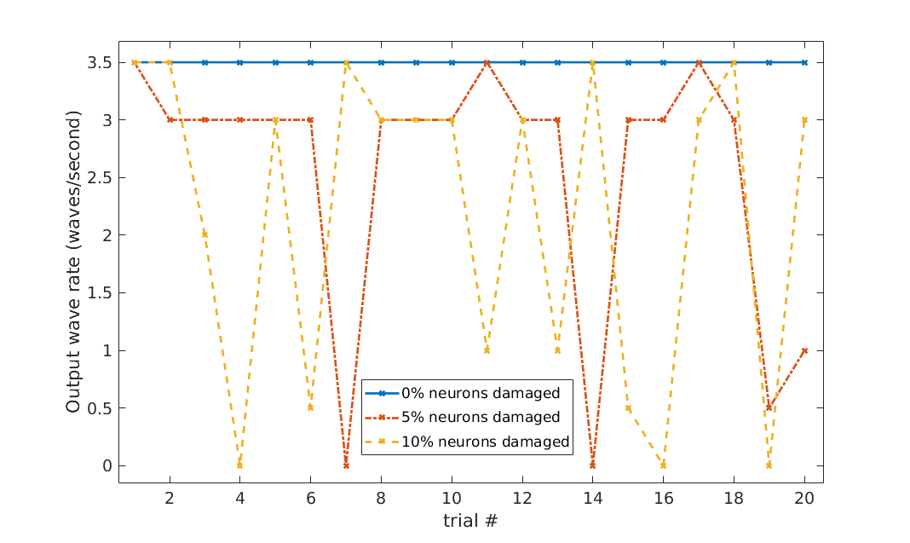
Damage experiment – one SCE
20 trials using the same starting SCE (2x2x10, 40 neurons total) and the same stimulus. Connection strength is 24, stimulus firing rate fixed at 21.
Randomly pick neurons to remove for each trial (5% = removed two neurons, 10% = removed 4 neurons). The “0% damage” SCE is the same for all trials.
The SCE has some resilience, but even removing 2 neurons can cause the firing rate encoding to fail (trials 7 and 14)

Slide 8
SCE population morphology
We imagine 3 types of SCE populations:
A single “thickened” SCE with greater X and Y extents
A population of independent SCE with no cross-connections
A population of coupled SCE where the inter-SCE connections are less dense than the connections within each individual SCE
We examine these population types to answer 2 questions:
Which population types are most resilient to damage? Measured by comparing the activation function after damage to the activation function before damage
Which population types are most efficient? Measured by comparing the total # of spikes required for the same activation function

Slide 9
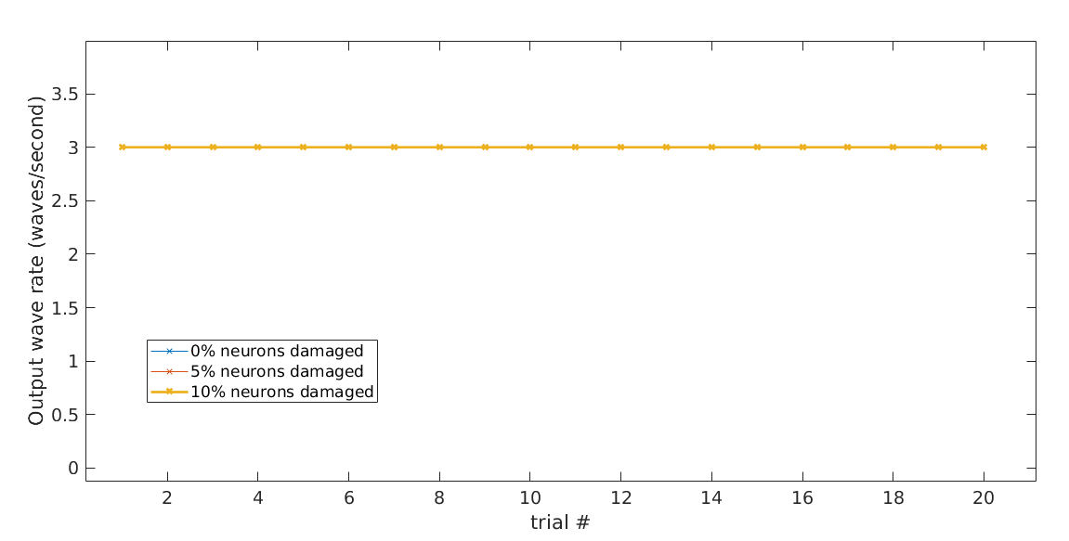
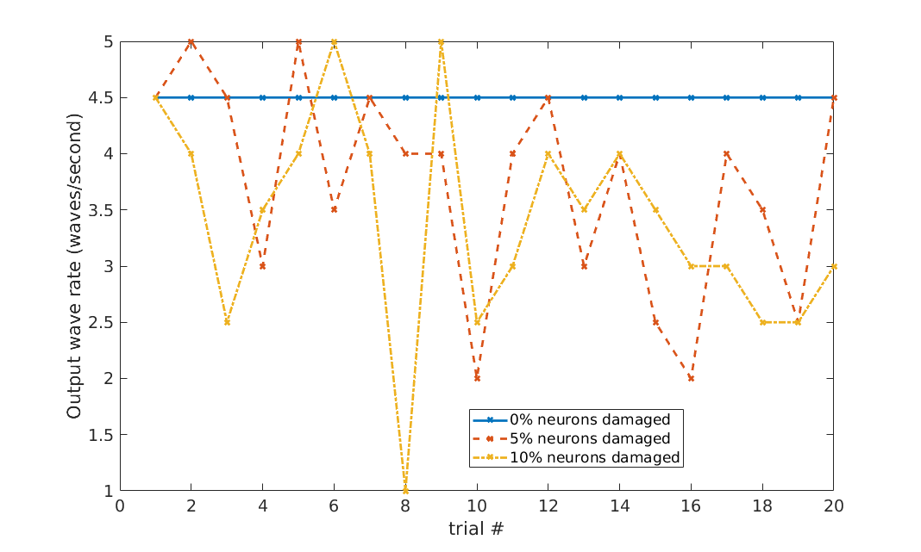
Morphology comparison
Experiments on three different morphologies of a 4x4x10 population
One big 4x4x10 SCE – highly resistant to damage
4 independent 2x2 SCE – not resistant to damage

Slide 10
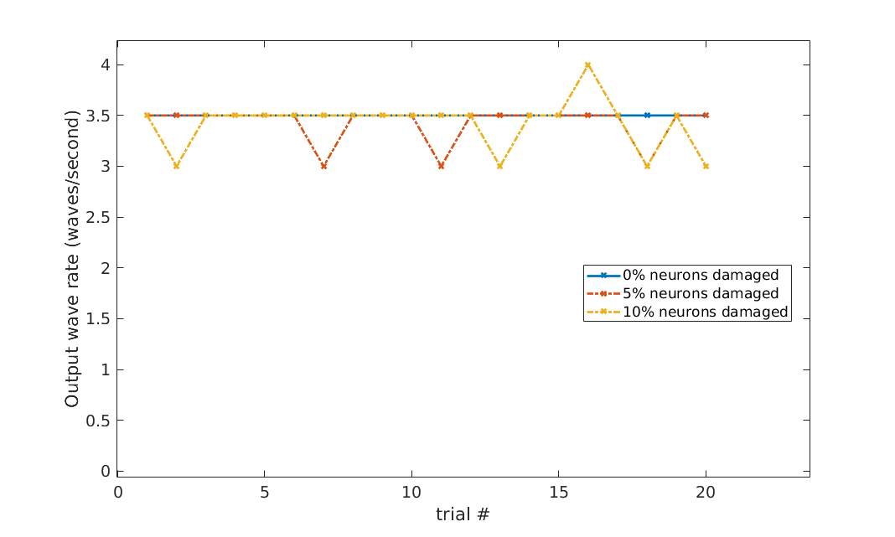
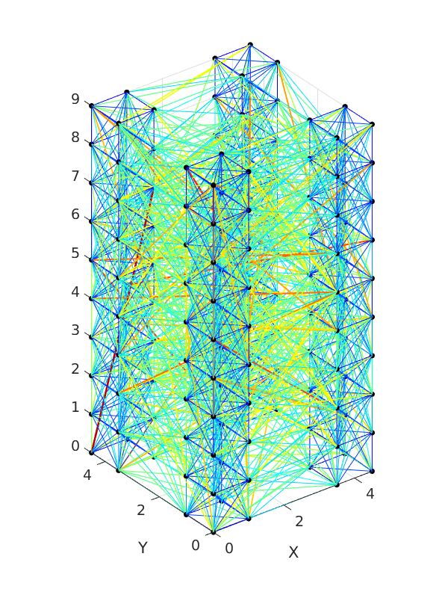
Morphology comparison
4 Coupled 2x2 SCE– highly resistant to damage

Slide 11
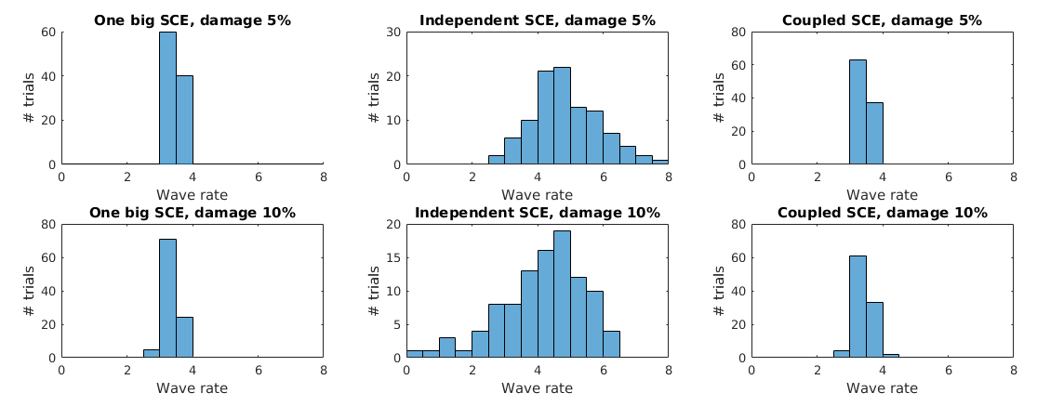
Morphologies – 100 trials
Over 100 trials, the “one big SCE” and “coupled SCE” columns maintain consistent wave rates
Independent SCE show substantial variation in wave rates

Slide 12
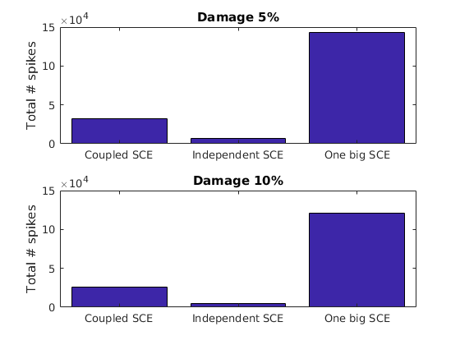
“Efficiency” (number of spikes)
The coupled SCE is more efficient than the big SCE when measured via total # of spikes emitted. The coupled SCE and big SCE have similar activation functions (see previous slide) so the same number of traveling waves traverse both populations.
The independent SCE is most efficient, but the activation function is not reliable (see previous slide).

Slide 13
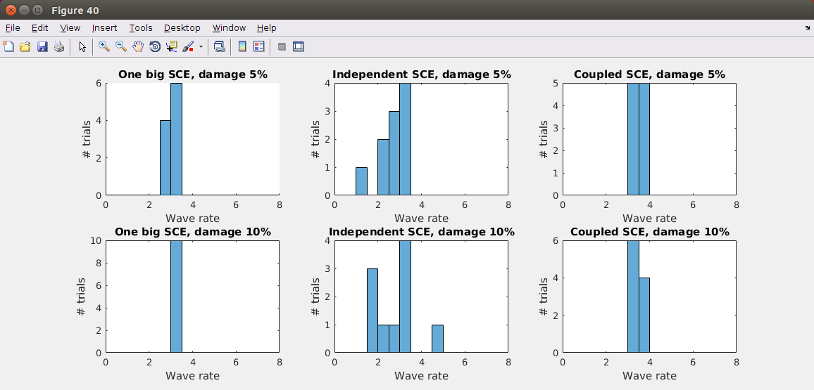

Slide 14
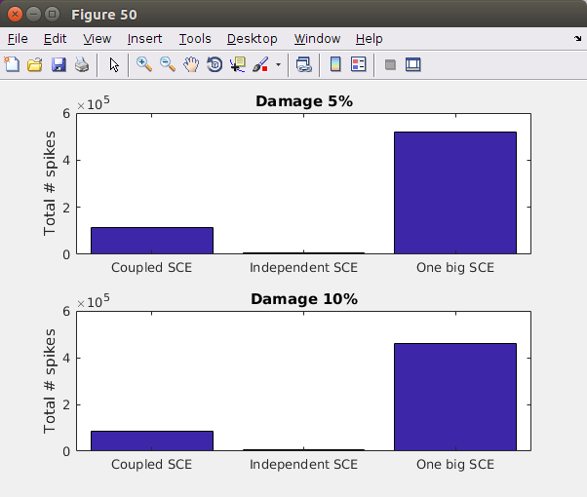

Slide 15
Backup/Old material

Slide 16
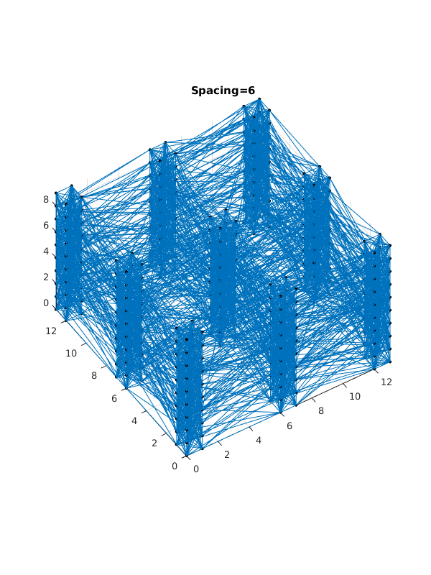
Experiment
Output from top layer of SCE
SCE, various topologies possible
Spike raster plot of a population of 50 neurons with a 10 Hz average firing rate.
Input to base layer of SCE
Population of neurons whose average firing rate we want to encode and transmit
2 seconds

Slide 17
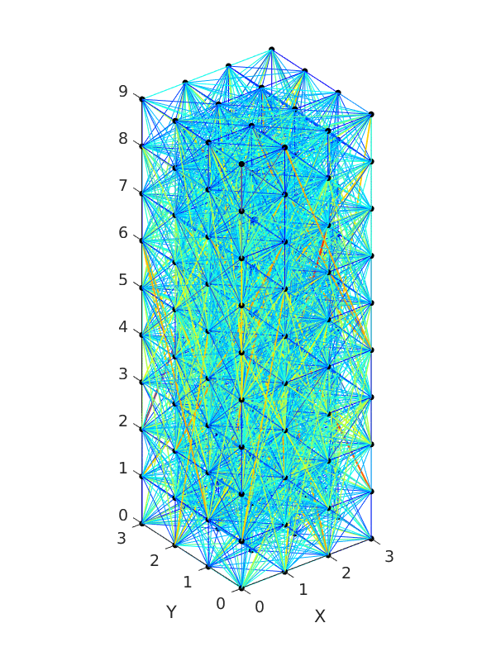
Two SCEs studied
4x4 SCE
SCE with 4 columns, each 2x2

Slide 18
Firing Rate converted to Wave Rate
Input population firing rate 1 Hz
Input population firing rate 21 Hz
4x4 SCE
4 columns, each 2x2
A higher firing rate in the input population results in a higher rate of traveling waves propagating through the SCE. There is a maximum “traveling wave rate”, such that increasing the firing rate of the input population does not result in more frequent traveling waves.

Slide 19
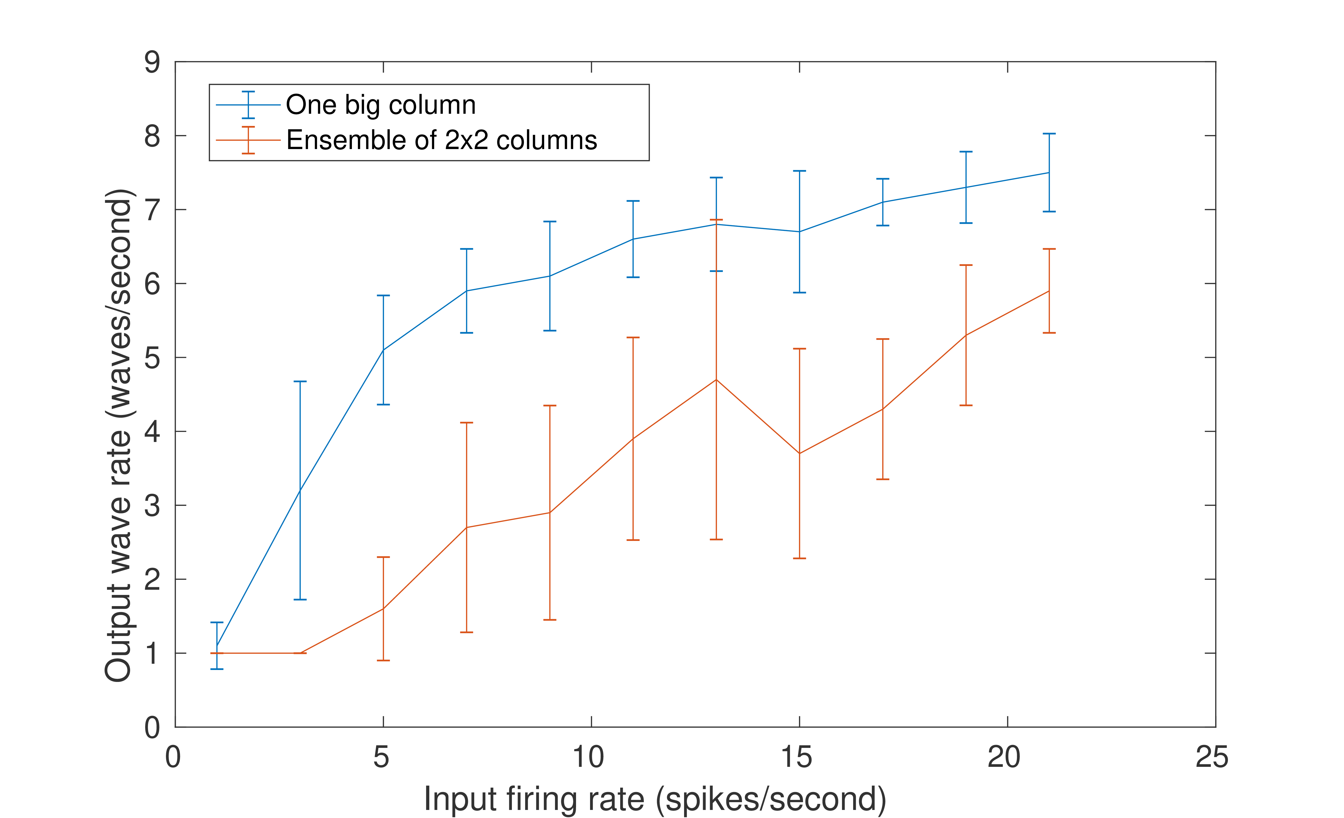
Representation of input firing rate
Error bars 1 std, 10 trials/point
The # of traveling waves/second encodes the input population firing rate. The one large column shows an activation function similar to the population activation function in Trappenberg section 3.4. The 4-column SCE shows a more linear activation function, but with more variation.

